Slide 1

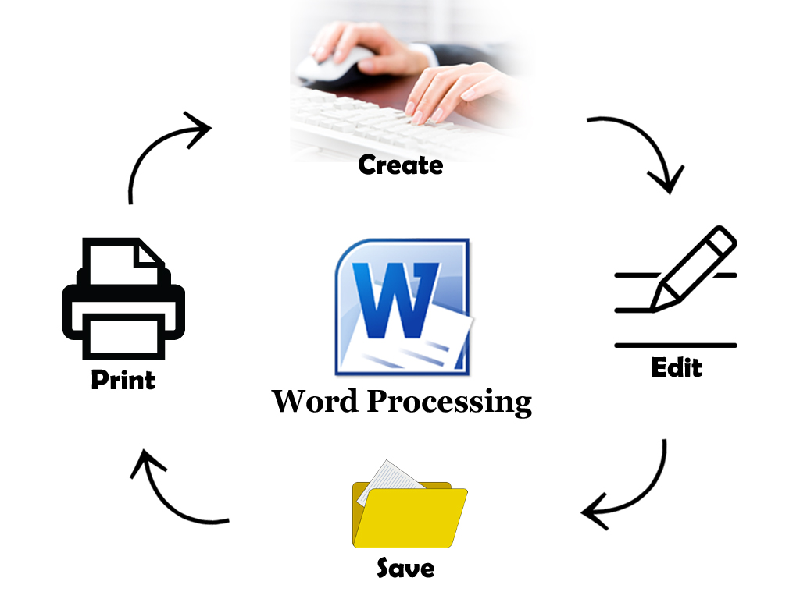


Word
Processing
Class V
lab 15

Slide 2

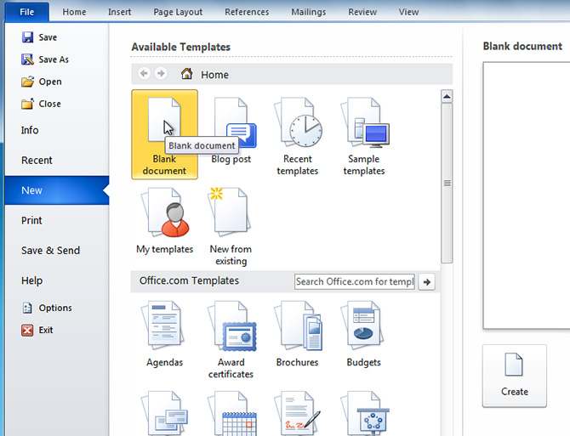
Opening Documents
Click the File tab. This takes you to Backstage view then Select New

Slide 3
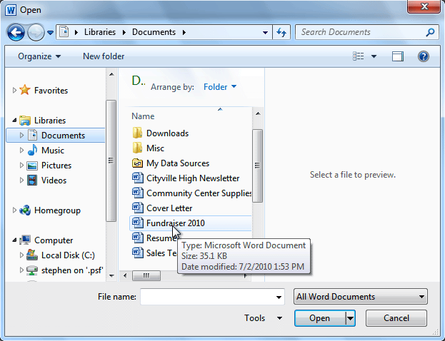
Opening Existing Documents
You can edit or make any change of an existing documents

Slide 4
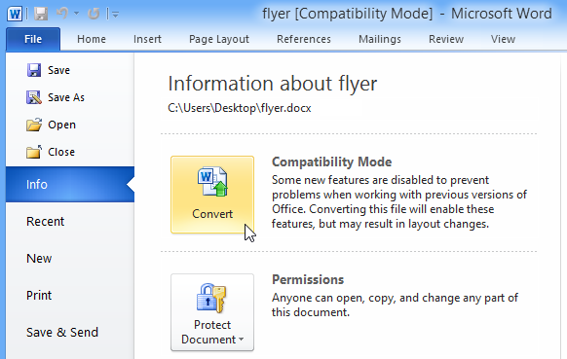
Convert Existing Documents
If you want access to all Word 2010 features, you can convert the document to the 2010 file format

Slide 5


